Slide 1
MFPE PROJECT AUDIT MANAGEMENT SYSTEM

Slide 2
AUDIT MANAGEMENT SYSTEM
TEAM MEMBERS
Nikunj Baid (2151965)
Chandu A B (2152912)
Nelluri Navyasree (2151470)

Slide 3
Project Overview
A leading Supply chain Management Organization wants to automate the Audit processing, to make the management scalable and ensure clarity and ease of tracking.

Slide 4
Plan of the project
DAY 1
DAY 3
DAY 5
DAY 6
DAY 8
DAY 10
DAY 11
Developing Microservices
Angular UI completed
Integrated frontend and backend
Testing
AWS
Deployment
Project Completion

Slide 5
Requirements
Hardware requirements
Pc / Laptop - 8 GB RAM preferably
Software requirements
Eclipse - Latest version
Node js
Lombok
Visual studio code
AWS access

Slide 6
TECHNOLOGY/FRAMEWORKS USED
FRONTEND
Angular
BACKEND
Spring MVC With Spring Boot
Spring Data JPA
H2 in memory DB
TESTING
Junit

Slide 7
Audit portal
Login
Choose audit type and view audit questions
Provide response and view the project execution status ·
Store the Audit date, Audit type, project execution status and remediation duration in database

Slide 8
SYSTEM ARCHITECTURE DIAGRAM
WORKFLOW
Audit
Authorization
Microservice
Audit portal
USER
Audit Severity module
Audit Checklist module
Audit Benchmark module

Slide 9
MICROSERVICEs
Audit authorization
It creates JWT (JSON Web Token) for an authenticated user who is in Database and then it validates the user based on the JWT token passed in the "Authentication"-Request-Header.
Method:
GET:/health-check
POST:/authenticate
POST:/validate

Slide 10
Audit Authorization
End Point:
/auth/authenticate
Username and password
Check the username and password
Generate a JWT token

Slide 11
Audit Authorization –validation
End Point:
/auth/validate
response as Json containing details [name, projectName, isValid]
JWT Token

Slide 12
Audit benchmark
It is a middleware microservice which stores the number of acceptable “No” in the database based on Audit Type.
It uses data.sql which stores Benchmark ID, Audit Type and Benchmark “No” answers.
It is used to pass the number of list of acceptable “No” to audit-severity microservice.
Method:
GET:/audit-benchmark
GET:/health-check

Slide 13
Audit benchmark
End Point:
/benchmark/AuditBenchMark
JWT Token
returns List of BenchMark

Slide 14
Audit checklist
It is a middleware microservice which gets the list of questions from H2 database.
It uses data.sql which stores Question ID, Question, Audit Type and Response.
The returned list is used by the audit-severity to display questions based on the type selected by the user.
Method:
GET:/AuditCheckListQuestions
GET:/health-check

Slide 15
Audit Checklist
End Point:
/checklist/AuditCheckListQuestions
JWT Token and type of audit
List of questions based on audit type

Slide 16
Audit severity
It is a middleware microservice which invokes audit-benchmark microservice and takes the list of acceptable “No” from it and it also takes questions from audit-checklist based on that generates the response.
It then checks the project execution status according to the pre-set rules.
It returns the status and remedial action to be taken.
Method:
POST:/ProjectExecutionStatus
GET:/health-check

Slide 17
Audit Severity
End Point:
/severity/ProjectExecutionStatus
Jwt Token and details of questions, their response, audit type and project details as json
audit id, managerName, projectName, ProjectExecutionStatus, remedialActionDuration of the project which are in red as json.

Slide 18
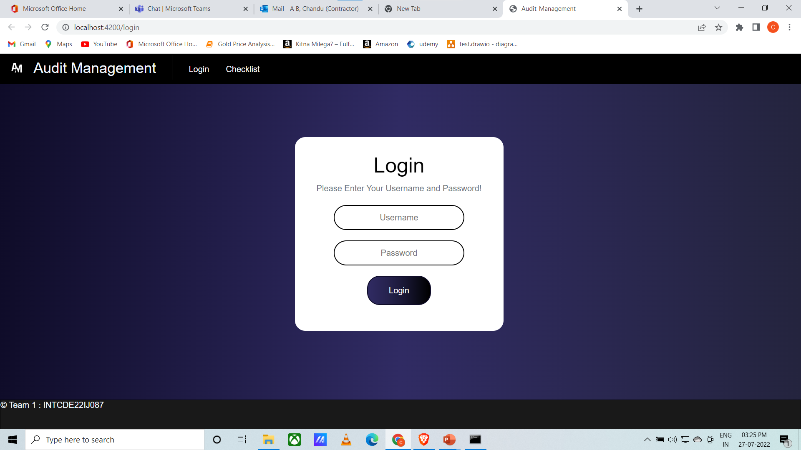
UI Screenshots

Slide 19
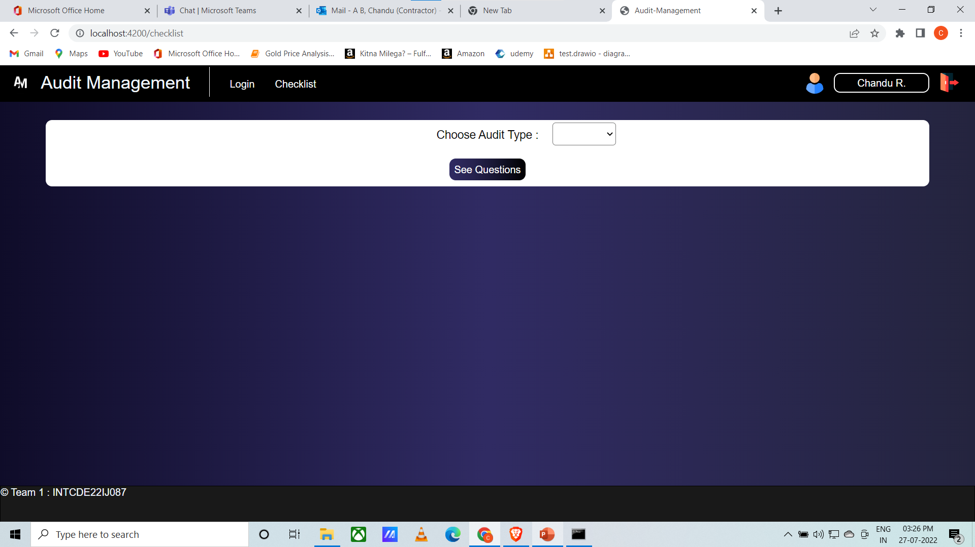

Slide 20
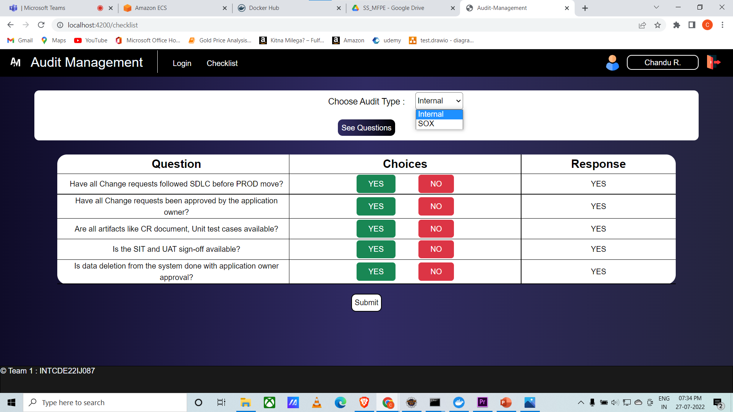

Slide 21
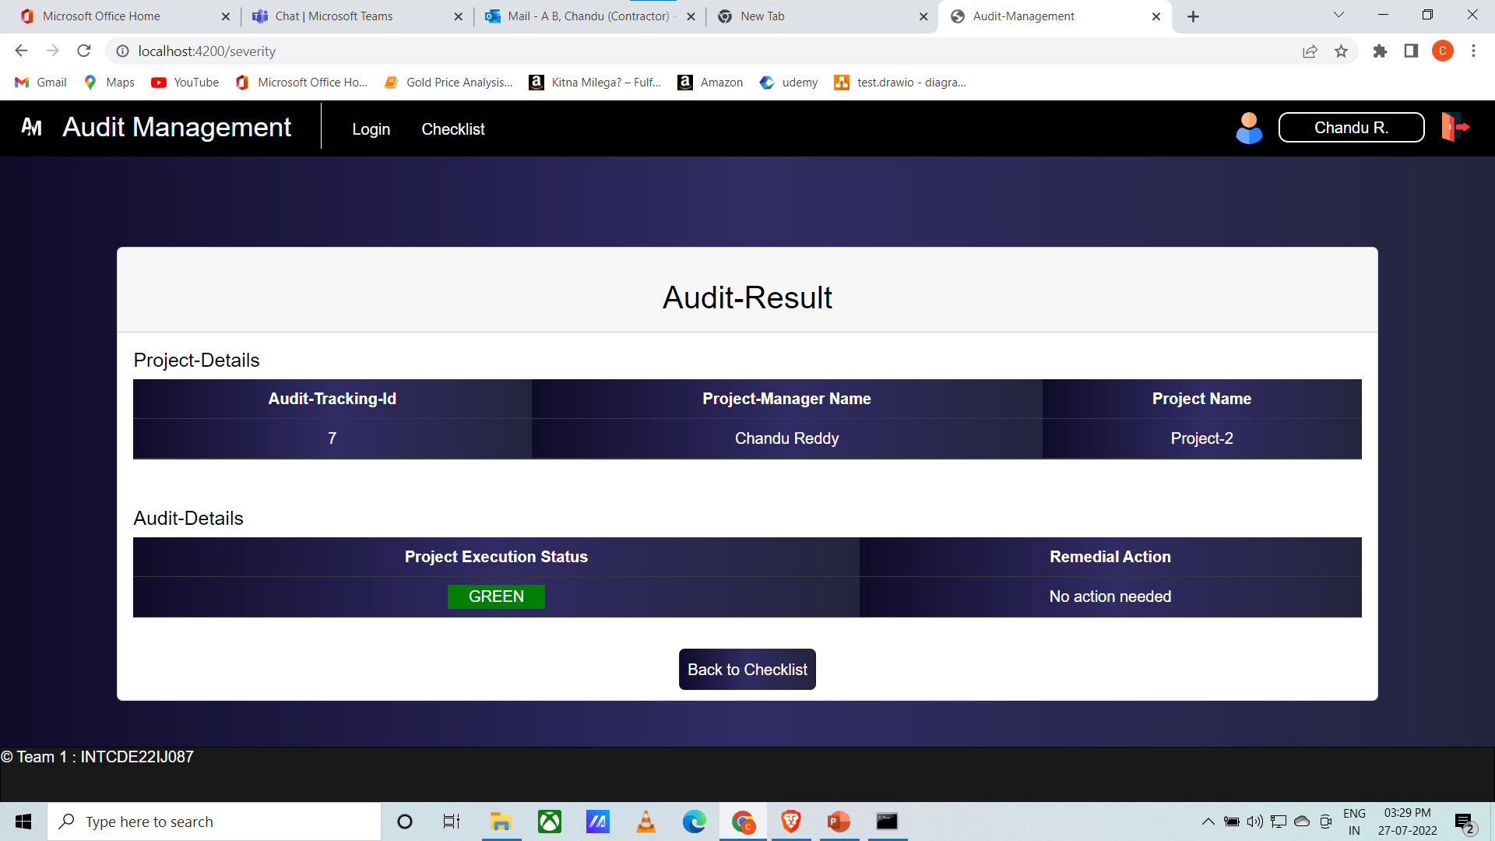

Slide 22
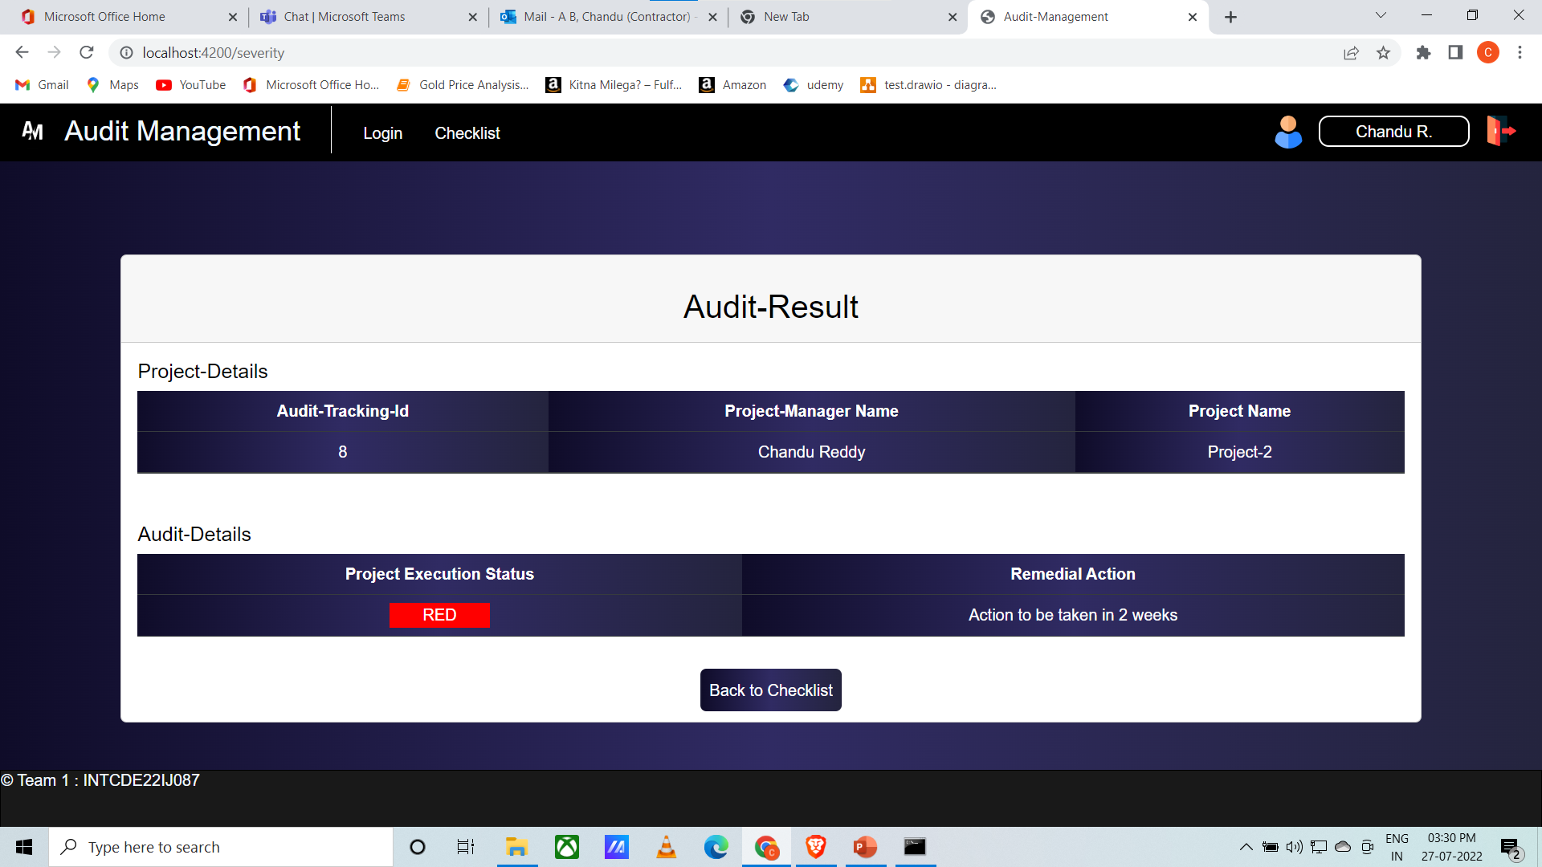

Slide 23
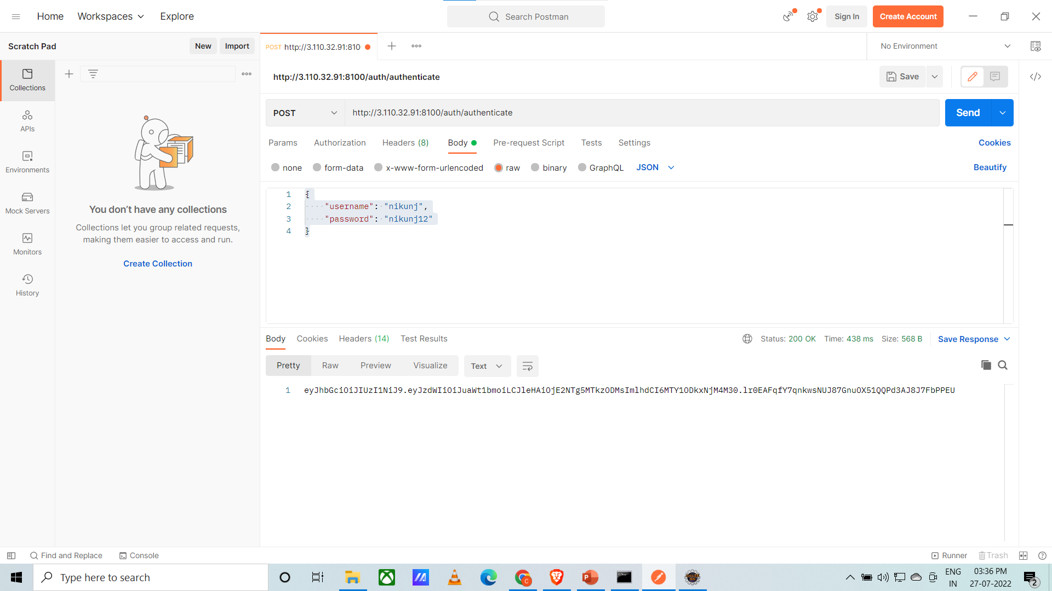
Postman Screenshots

Slide 24
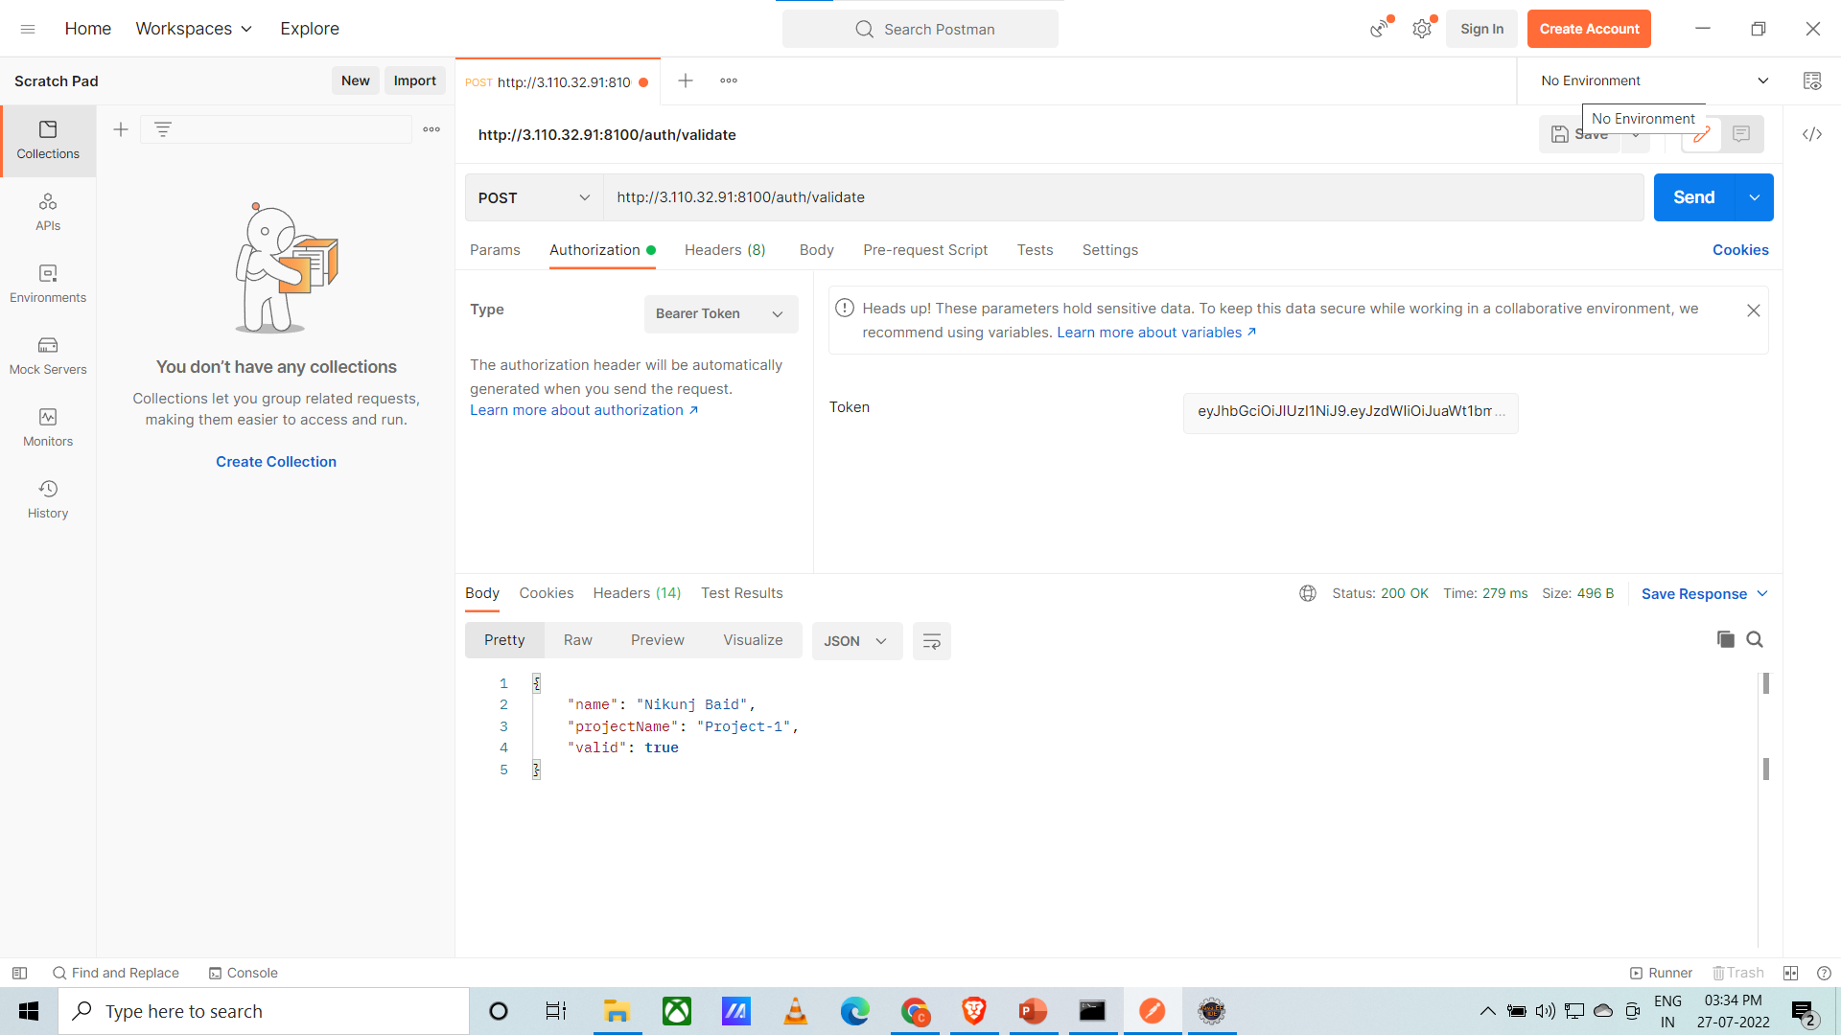

Slide 25
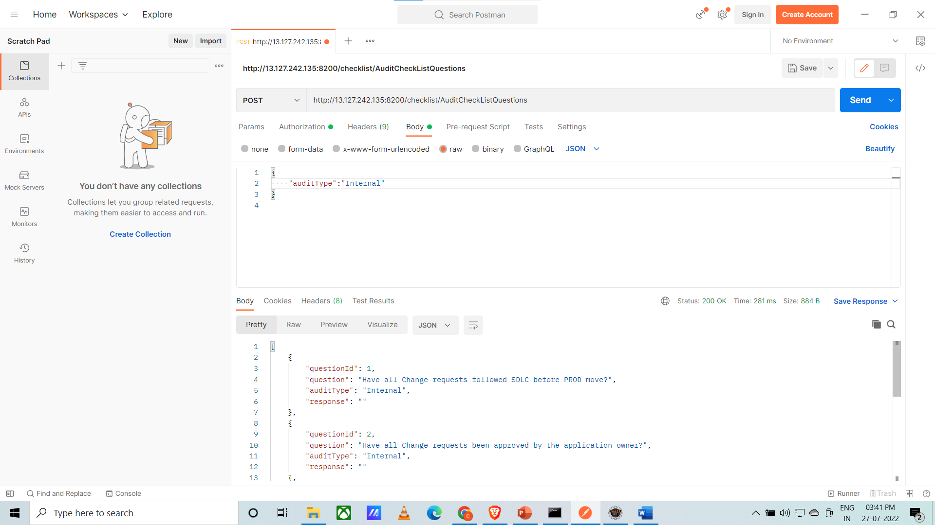

Slide 26
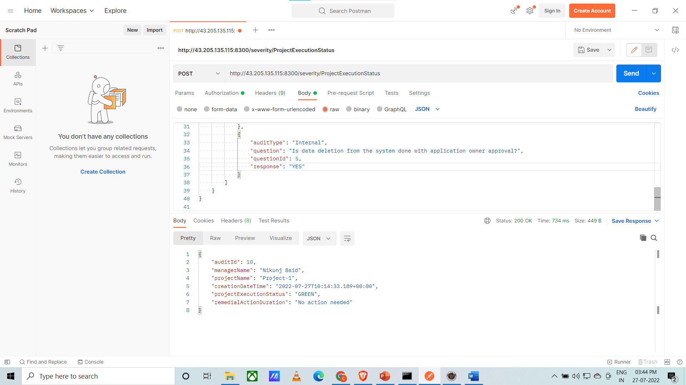

Slide 27
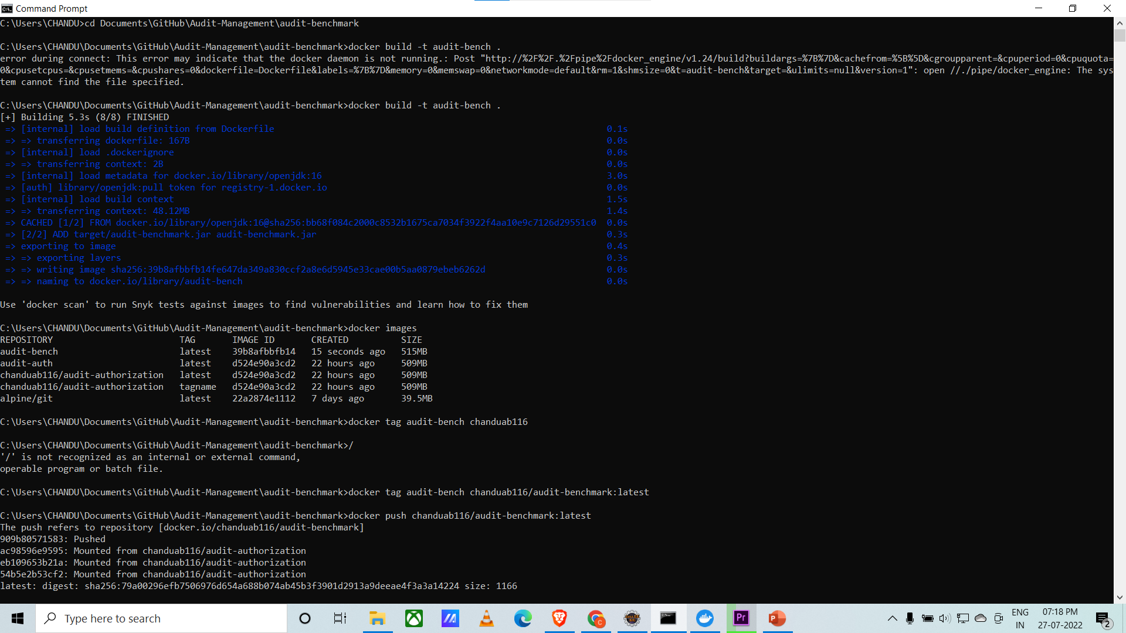
Docker Screenshots

Slide 28
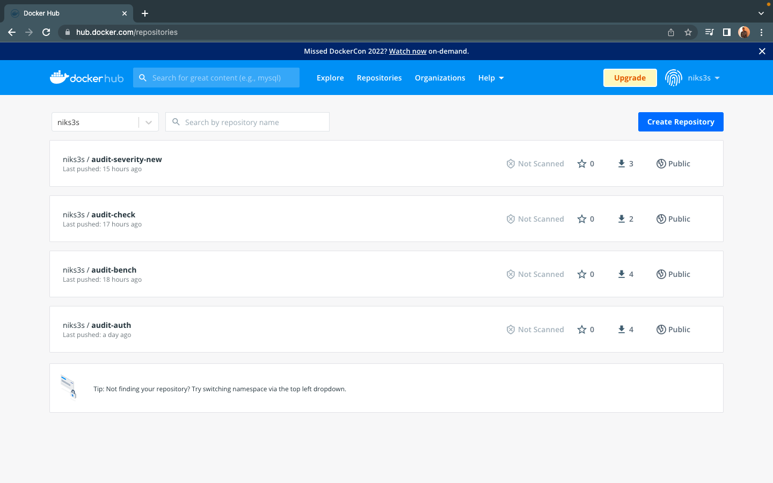

Slide 29
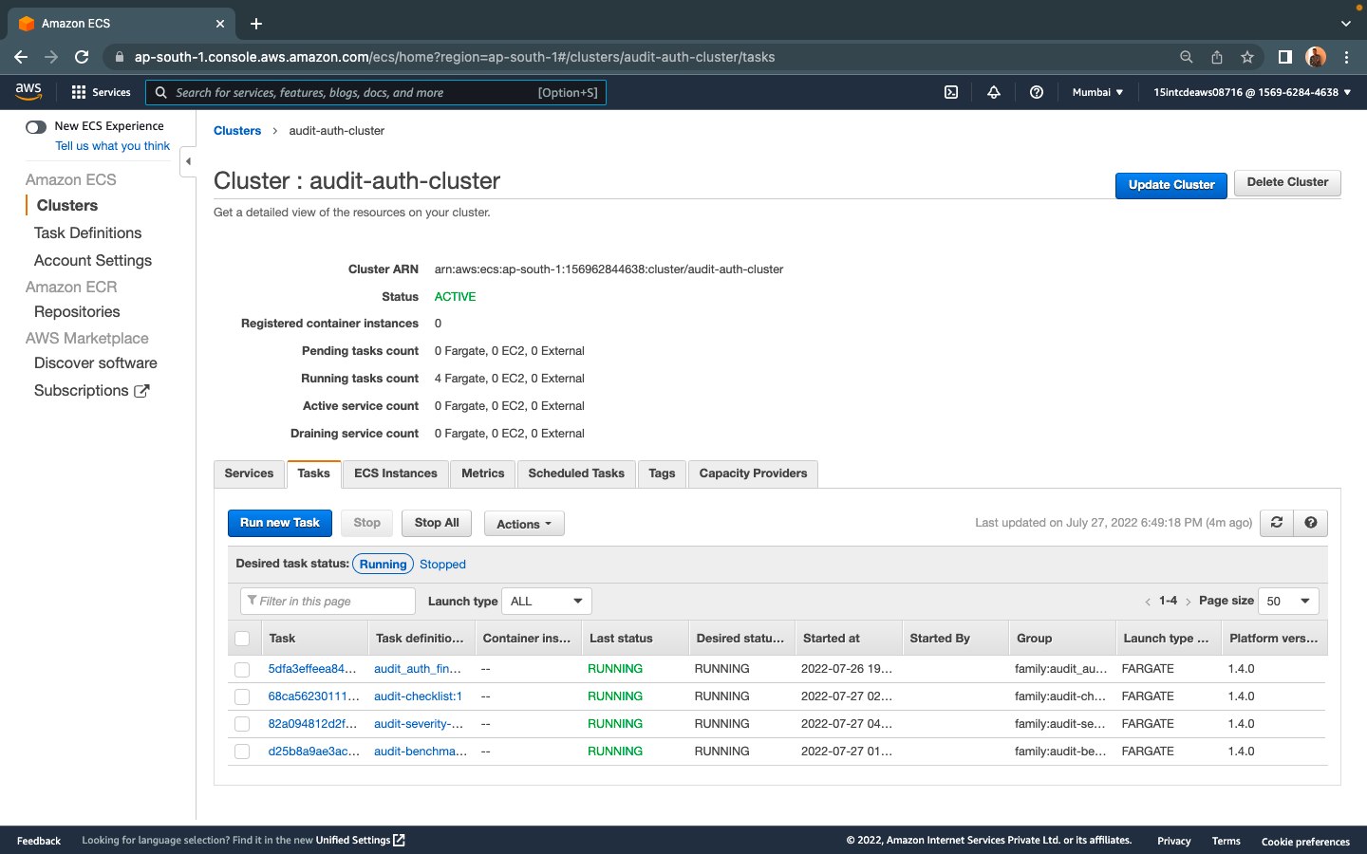
AWS CLOUD DEPLOYMENT

Slide 30
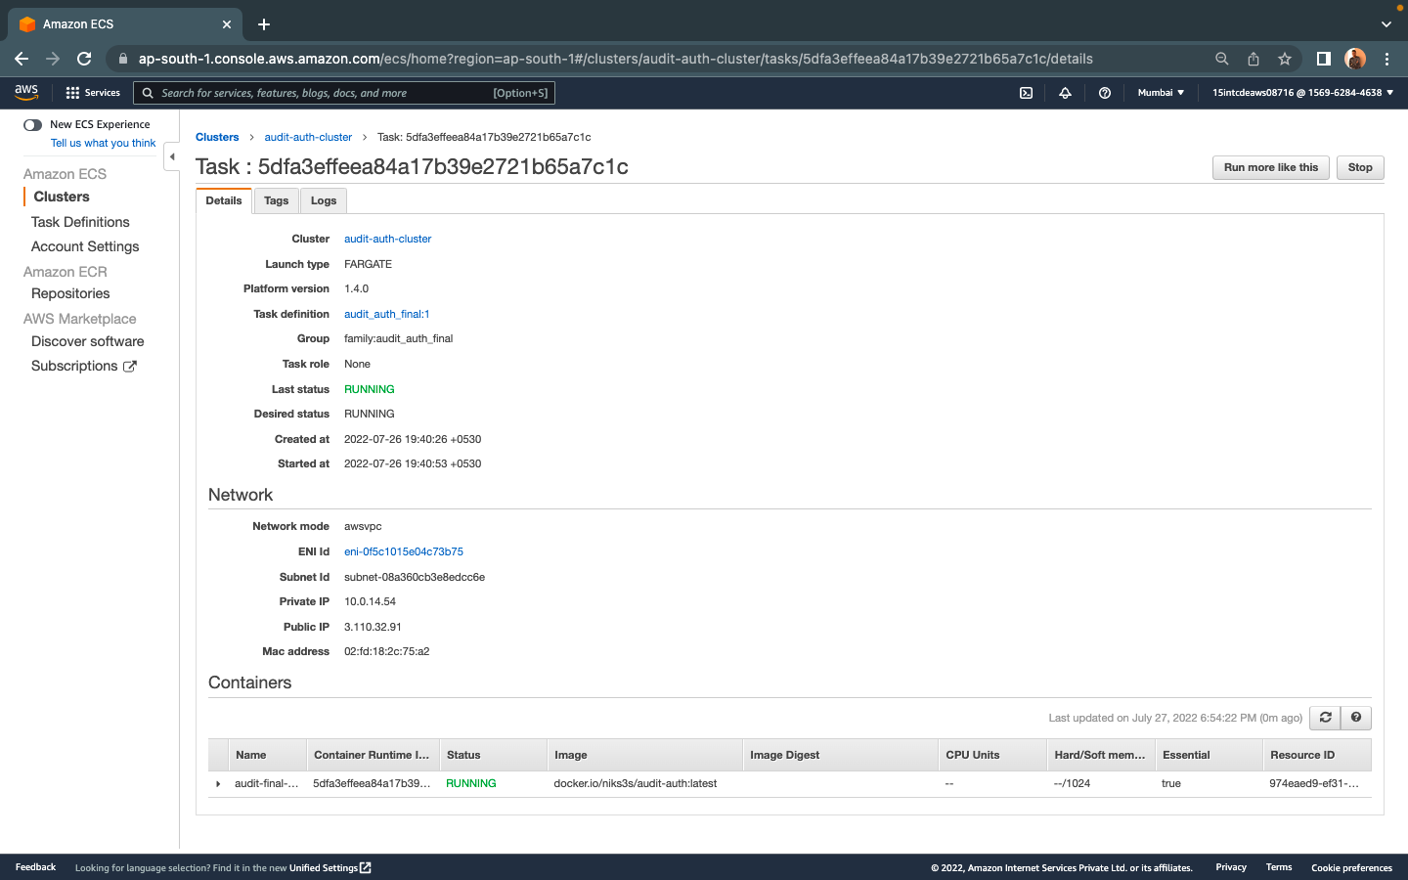

Slide 31
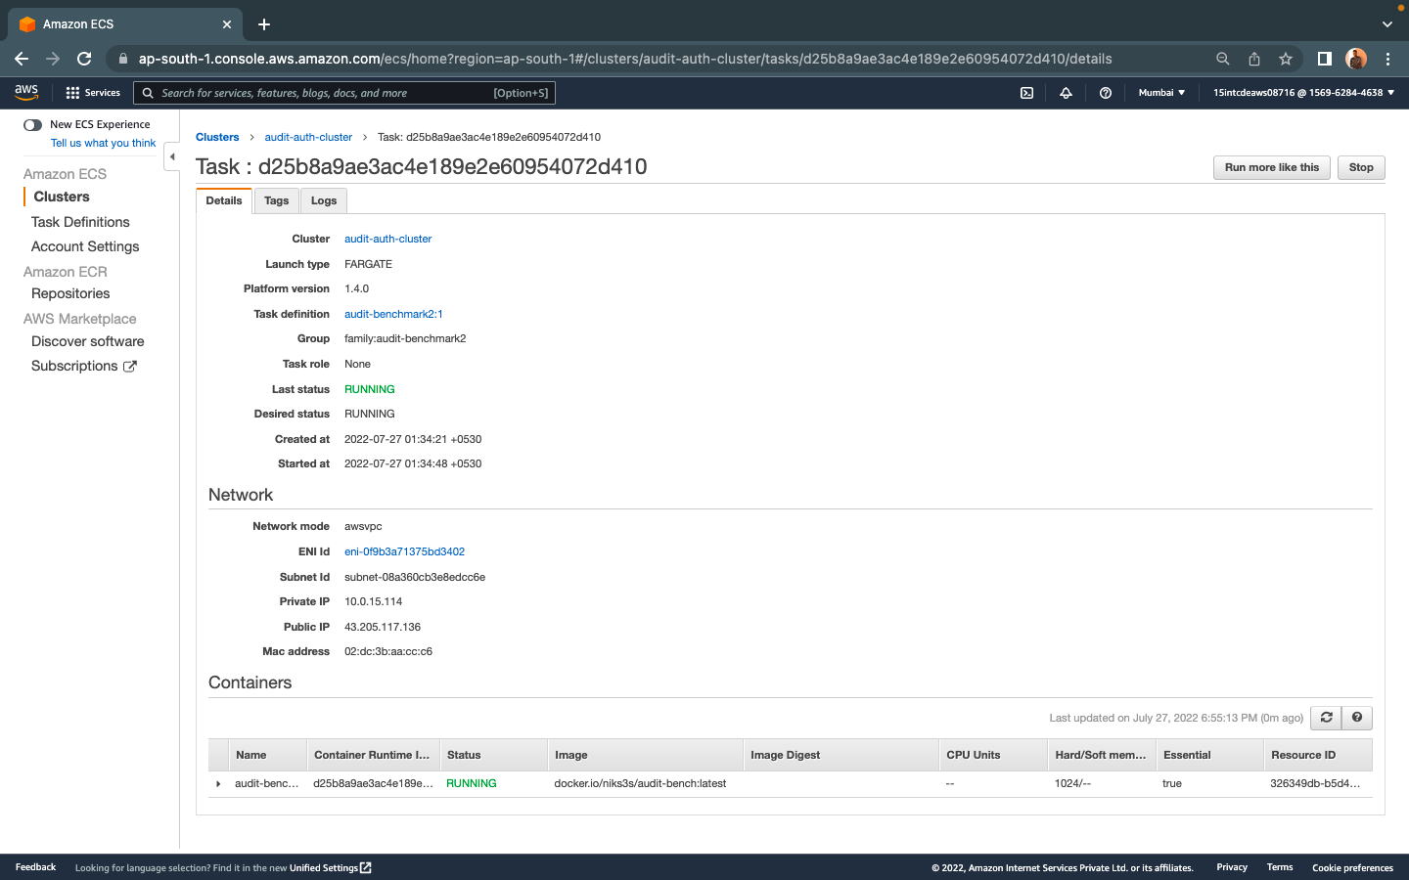

Slide 32
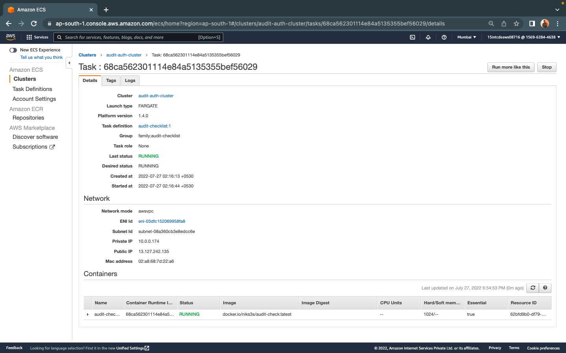

Slide 33


Slide 34
AWS DEPLOYMENT VIDEO

Slide 35
THANK YOU

